Slide 1

PHP
SECURITY FORM VALIDATION

Slide 2

OBJECTIVES FOR TODAY
Understand how XSS attacks work
Know how to sanitize data to secure the website - htmlspecialchars –
Validate the data input by user in a form
- TRIM – to remove the first and last spaces

Slide 3


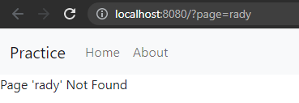
Activity 1
EXPLORE
10 MIN
INDIV
Run the server on localhost on port 8080 (php -S localhost:8080)
On the browser, check what is displayed if the value of parameter ‘page’ is not valid

Slide 4

Activity 1
EXPLORE
10 MIN
INDIV
What’s happen if we put HTML tags in the value of ‘page’ ?

Slide 5
Activity 1
PRACTICE
10 MIN
INDIV
What’s happen if we put HTML tags in the value of ‘page’ ?
TRY THIS (teacher sends the link): http://localhost:8080/?page=%3Cscript%3Ealert(%27Hacked!%27)%3C/script%3E
Try to explain what ‘s happen with this URL

Slide 6

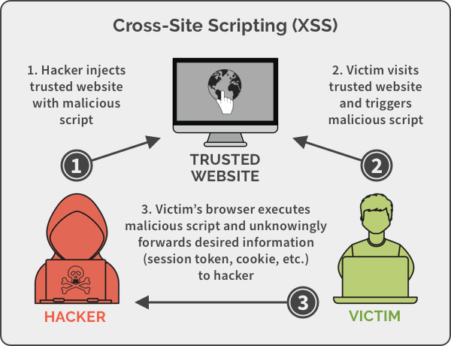
EXPLAIN
What is XSS attack ?
Cross Site Scripting
10 MIN
CLASS
A XSS is a way to inject a script on a website
1- The script is executed on the client’s browser
2- hacker get private data

Slide 7
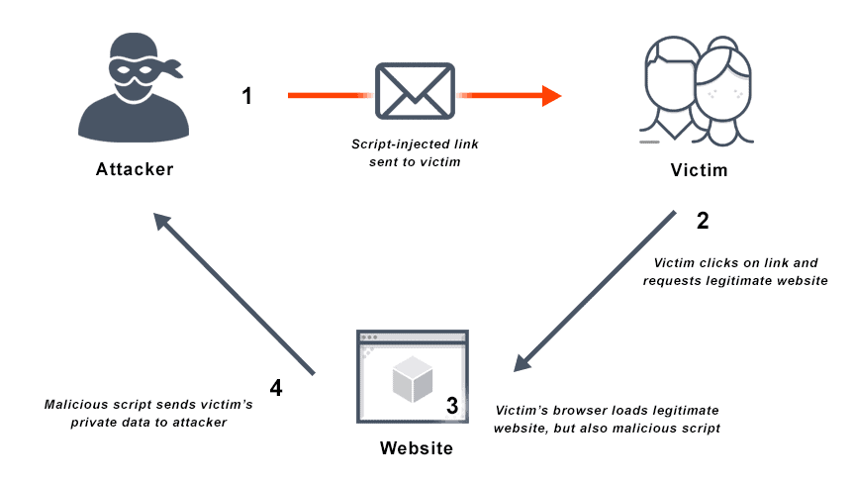
EXPLAIN
How can a hacker inject a script into the website ?
10 MIN
CLASS
Using a LINK with malicious GET parameters, and send it to the victims

Slide 8

EXPLAIN
How to secure my website ?
10 MIN
CLASS
PHP function htmlspecialchars converts “<“ and “>” characters so that browser doesn’t interpret it as HTML tags
Now secure the website from activity 1 using htmlspecialchars function !

Slide 9
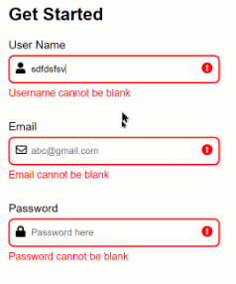

Form validation

Slide 10
Why you need validation ?
EXPLAIN
05 MIN
CLASS
Never trust data that the user can input in your app!
Check data integrity :
Check the data is in the correct format
Check the data complies to the constraints of the application

Slide 11

Cleaning user input
EXPLAIN
05 MIN
CLASS
The trim function removes spaces and line breaks at the beginning and end of a string
=> useful to clean input from user

Slide 12
Activity 2
PRACTICE
15 MIN
INDIV
Add validation of inputs from form
When submitting form, the application should display an error message near incorrect fields
The inputs should be cleaned from extra spaces at the beginning and end
It should be secure against XSS attack

